Slide 1
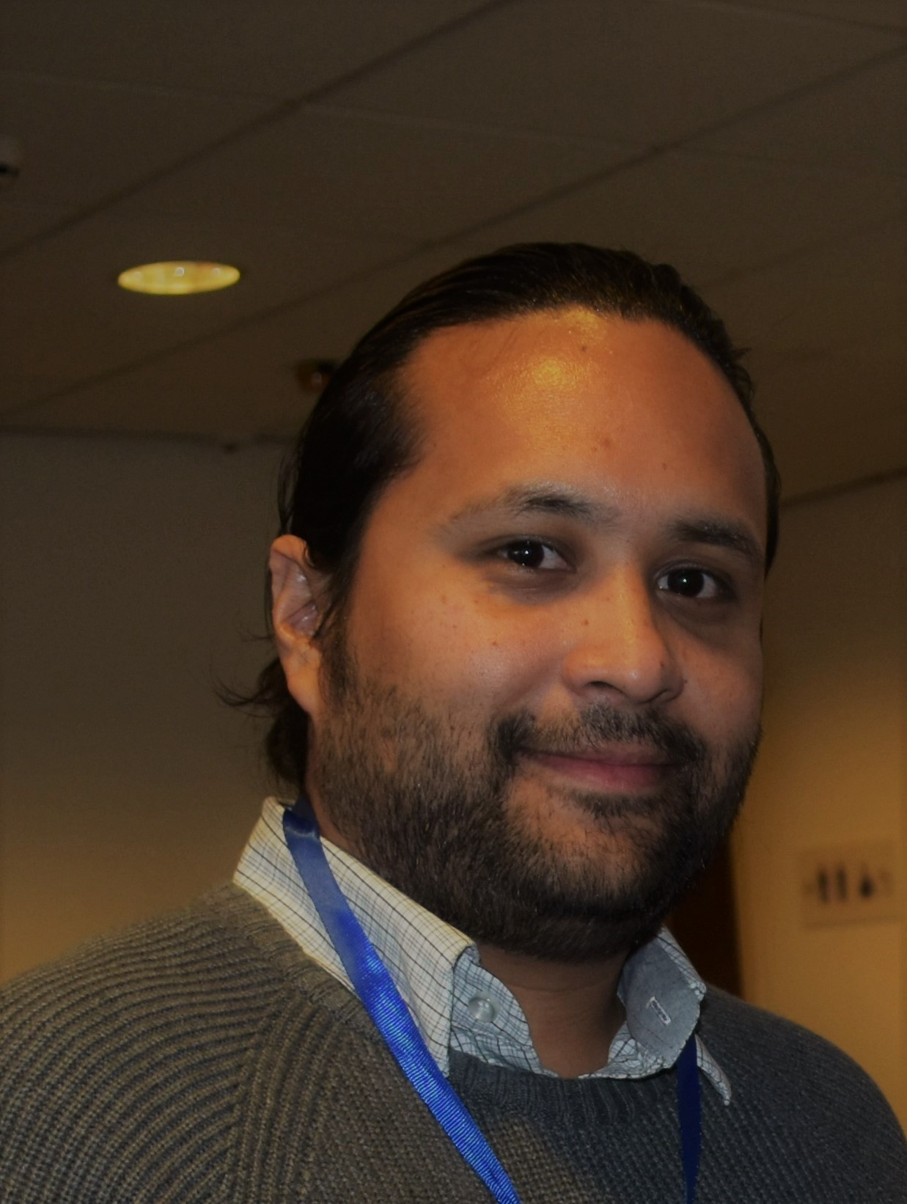
Laboratory 7
ImageNet
Master in Big Data Solutions 2020-2021 - Artificial Intelligence
Luis Salgueiro
luis.salgueiro@bts.tech

Slide 2
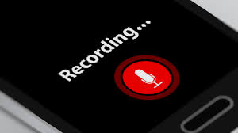
Reminder
Is this webinar being recorded?

Slide 3
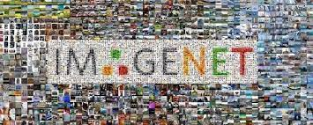
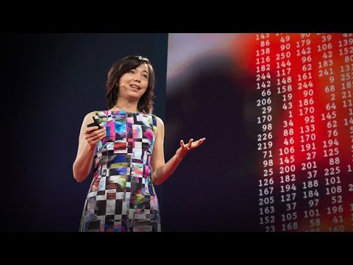
ImageNet
+15M images labeled over +15K classes
Credits: https://datasmarts.net/es/que-es-imagenet-y-por-que-necesitas-conocerlo/

Slide 4
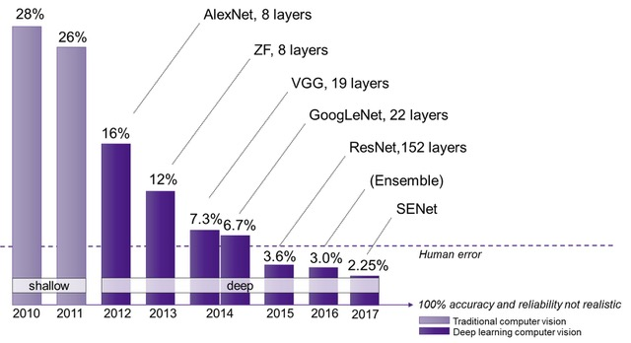
ImageNet
Imagenet Large Scale Vision Recognition Challenge (ILSVRC)
Use a sub-set of ImageNet
1000 samples of 1000 classes.
Total dataset: 1.2M samples
1M samples for training.
50k samples for validation
150K samples for test
Credits: https://semiengineering.com/new-vision-technologies-for-real-world-applications/

Slide 5
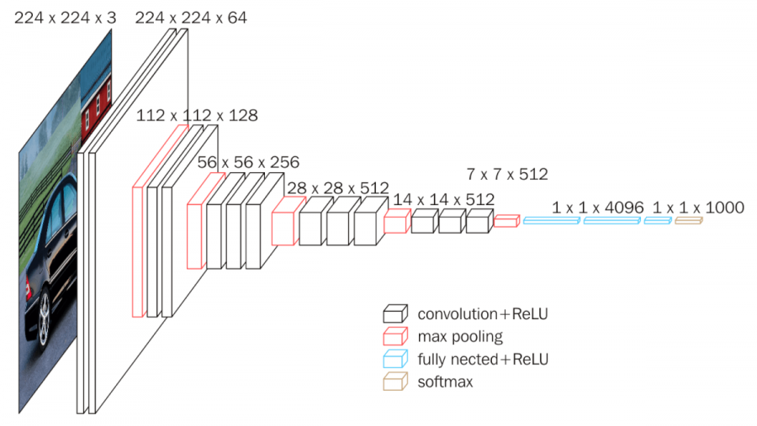
VGG-16 (2014)
K. Simonyan and A. Zisserman - Oxford U.
Credits: https://neurohive.io/en/popular-networks/vgg16/

Slide 6
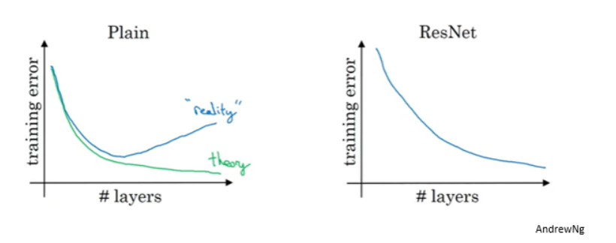
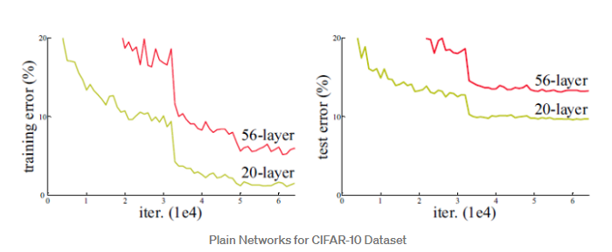
ResNet (2015)
Solves the problem of vanishing gradients.
Overfitting?
Credits:
https://www.pluralsight.com/guides/introduction-to-resnet https://towardsdatascience.com/review-resnet-winner-of-ilsvrc-2015-image-classification-localization-detection-e39402bfa5d8

Slide 7
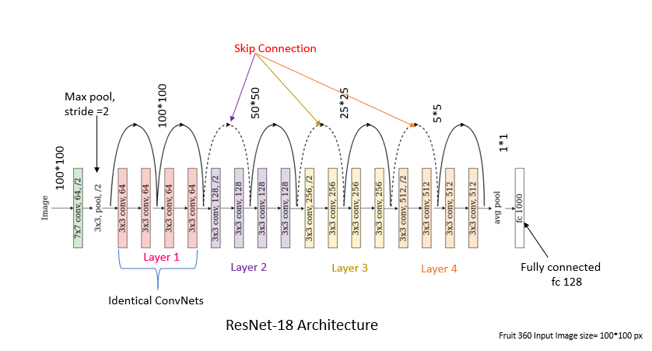
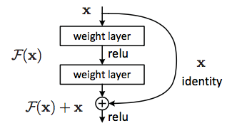
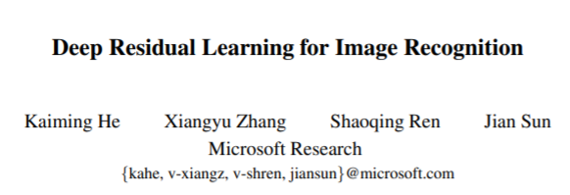
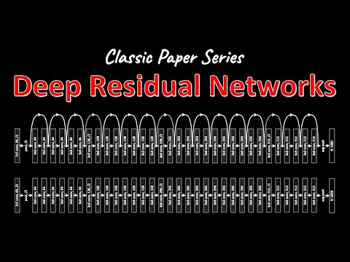
ResNet (2015)
Credits: https://neurohive.io/en/popular-networks/vgg16/

Slide 8
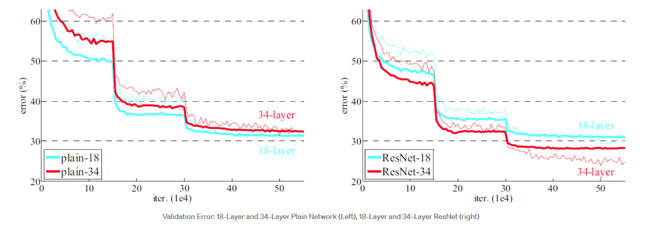

ResNet (2015)
Credits:
https://towardsdatascience.com/review-resnet-winner-of-ilsvrc-2015-image-classification-localization-detection-e39402bfa5d8

Slide 9
Agenda
In this lab exercises we are going to see:
How to use several pretrained model with Pytorch.
Dataset Augmentation with torchvision.
Transfer Learning and FineTunning.

Slide 10
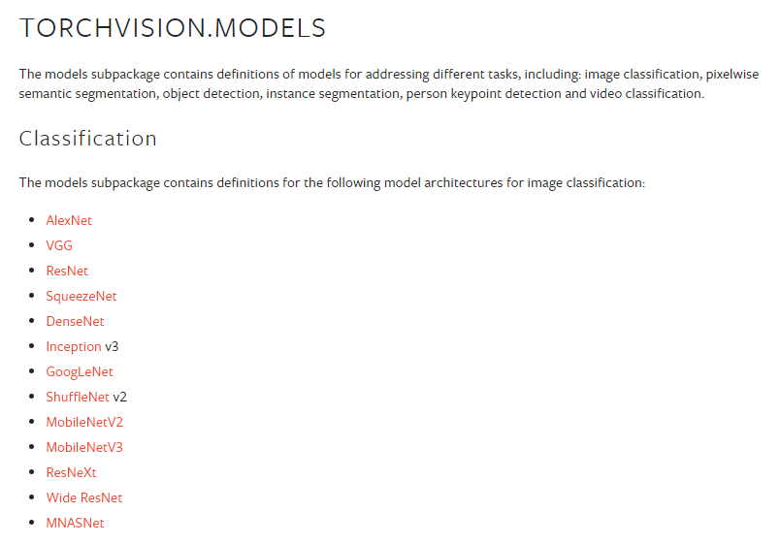
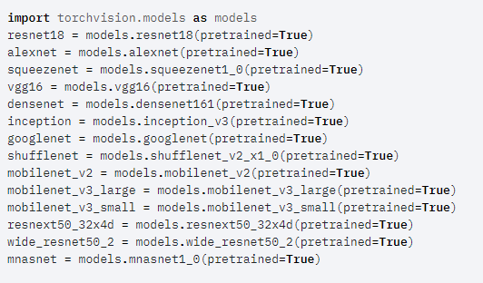
Torchivision models
Credits: https://pytorch.org/vision/stable/models.html

Slide 11
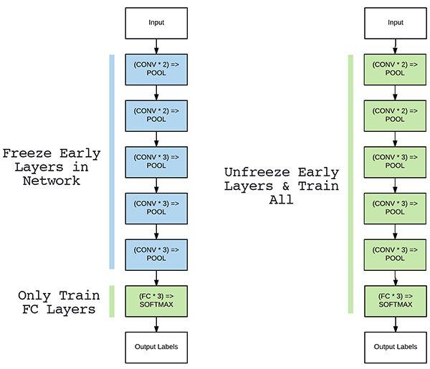
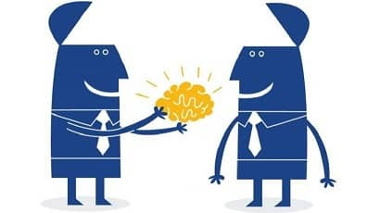
Transfer Learning
Credits: https://jeanvitor.com/transfer-learning-applied-to-image-recognition-of-similiar-datasets/
https://www.pyimagesearch.com/2019/06/03/fine-tuning-with-keras-and-deep-learning/
Notes:
By this properties it is that the CNN has locality and translation invariance.

Slide 12
